Slide 1


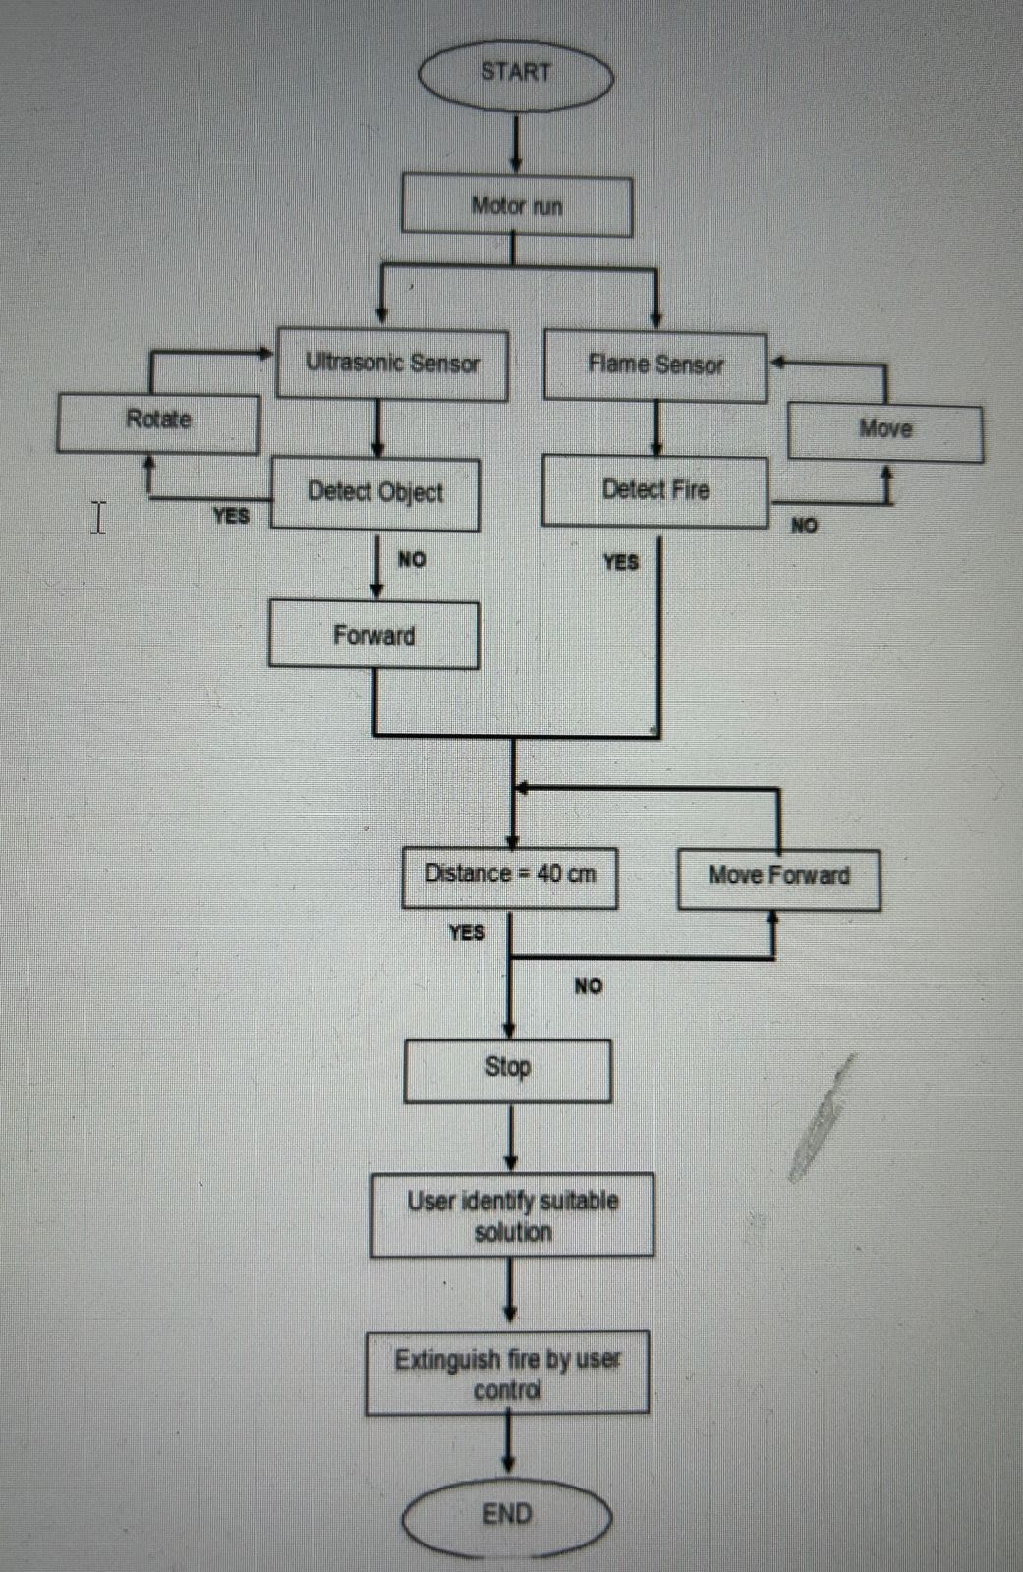
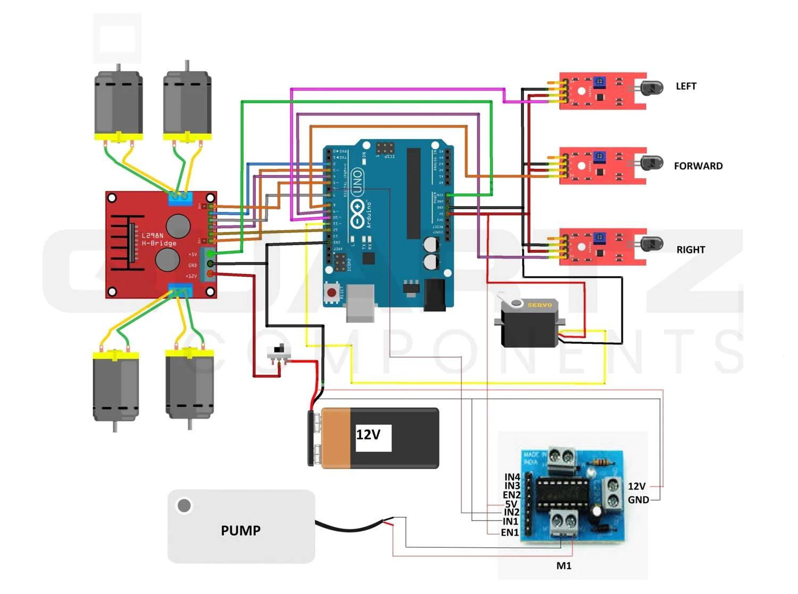
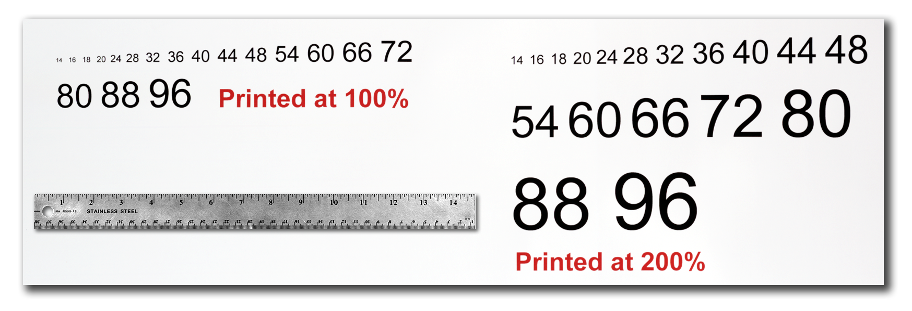
INSERT
LOGO HERE
INSERT
LOGO HERE
AUTONOMOUS FIRE FIGHTING ROBOT
Introduction
Altering The Column Layout
Result
"Introducing a Firefighting Robot: Revolutionizing Emergency Response
Our poster presents a cutting-edge firefighting robot designed to tackle hazardous situations efficiently and safely. Harnessing advanced technology, this robot is equipped with features such as heat sensors, extinguishing mechanisms, and autonomous navigation. By deploying this innovative solution, we aim to enhance firefighting capabilities, minimize human risk, and protect lives and property in emergency scenarios. Join us as we showcase the future of firefighting."
Depending on your content and how you wish to layout your poster, you may want to change the column layout of your poster.
This can be achieved quite simply by selecting one of the three master themes we have included. To select a different layout go to the DESIGN tab (Figure 5). Then you can easily select an alternate column layout from the options available.
Improved Efficiency: Demonstrated faster response times compared to traditional firefighting methods, reducing the spread of fire and minimizing damage.
Enhanced Safety: Successfully mitigated risks to human firefighters by autonomously navigating hazardous environments and executing firefighting tasks.
Effective Fire Suppression: Achieved successful extinguishment of fires using integrated extinguishing mechanisms, preventing further escalation.
Real-time Monitoring: Provided valuable data through sensor feedback, aiding in situational awareness and decision-making for emergency responders.
Figure 5
Methodology
ARCHITECTURE DIAGRAM
6
Conclusion
This project is about a real-time firefighting robot that moves at a steady pace, detects a fire, and then uses a pumping mechanism to put it out. The smoke sensor, gear motor and its driver, relay driver, and other components were all interfaced to the Arduino for detection and extinguishment. The robot communicates with a smartphone through Bluetooth and uses the analogue and digital data from the sensors to detect whether or not there is a fire in the vicinity. This project was successful in both hardware and software implementation. The "Arduino controlled firefighting robot" can be employed in a variety of settings, including residences, laboratories, parking lots, supermarkets, stores, and businesses.
A
B
.
Acknowledgements
Text Sizes
For this poster template the Arial font family is used at several recommended text sizes. You can use any typeface you like and at any size but try to stay close to the suggested limits.
Figure 4 gives a visual reference of what different font sizes look like when printed at 100% and at 200%.
Due to a page size limitation in PowerPoint and unless your poster is going to be less than 56” in length, all the work done on this template is at half the size of the final poster. For example, if you choose a 21 point font for this poster, the actual printed size will appear as 42 points.
Implementation Part
Robust Design: Utilizing durable materials and components for resilience in high-heat environments . Sensor Integration: Incorporating state-of-the-art heat and real-time fire detection . Autonomous Navigation: Implementing advanced algorithms for precise and efficient movement in complex environments . Extinguishing Mechanism: Integration of firefighting tools such as water cannons or foam dispensers for effective fire suppression
Figure 4

